Slide 1
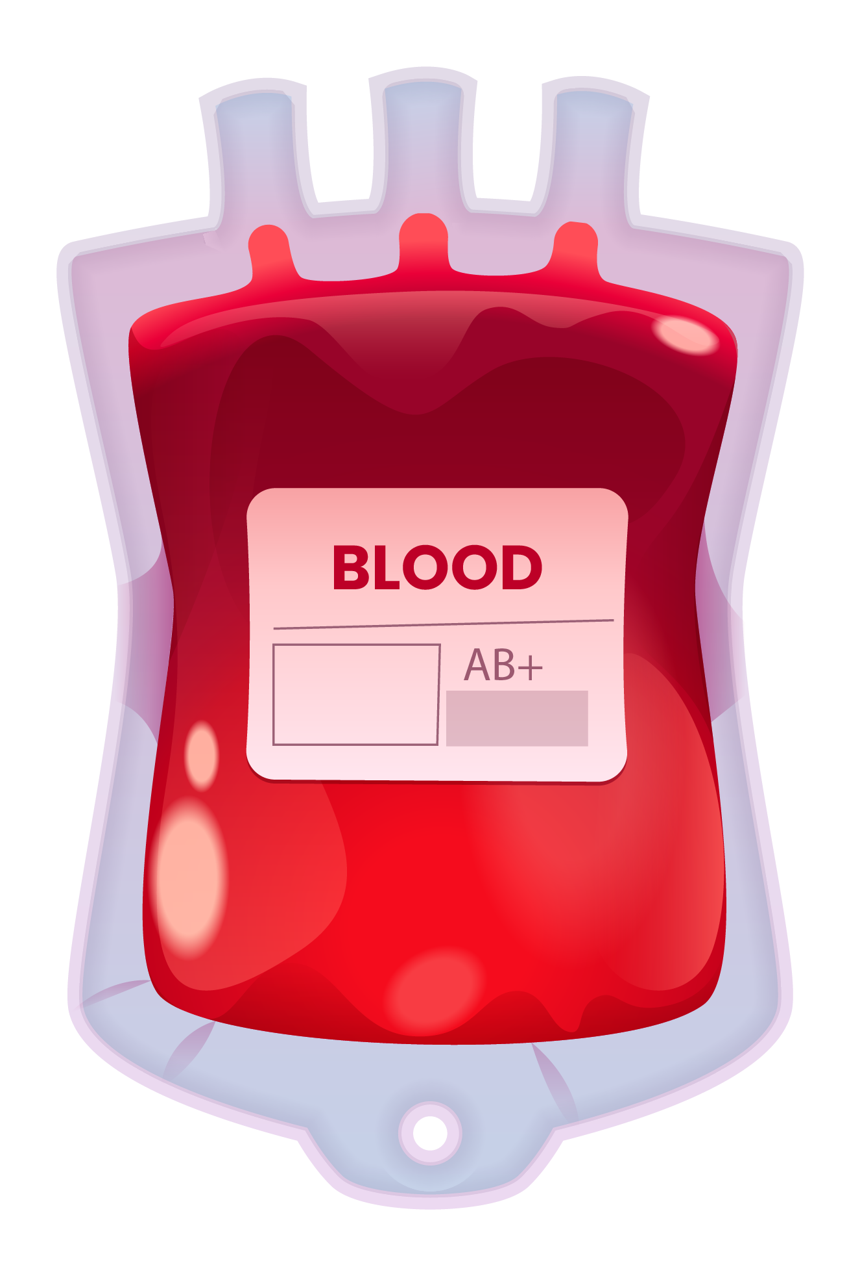
BLOOD BANK BAHRAIN
Website & Application
Name: Yusuf Abdulrahman Shareeda ID: 6200569
Supervisor: Dr. Asdaque & Dr. Mira

Slide 2
Project aims
Improve Blood Bank Bahrain (BBB) services by making it more visible and accessible, making it easier to find donation locations, and facilitating information access.
Add easy-to-use options in the app and website to simplify donation steps and get more people involved in donating.
Use technology well to connect donors and recipients, ensuring blood products get where they're needed quickly and correctly.
Enhance Blood Bank Bahrain (BBB) operational effectiveness by managing staff availability and scheduling as efficiently as possible.
Encourage community involvement and dedication to blood donation by providing an approachable platform with the goal of saving lives.

Slide 3
Problem definition
In recent years, all blood transfusion processes have been conducted in hospitals and continue to do so, which is why they take a long time and cause abnormal congestion.
This project will improve this process both in terms of time for people and in terms of the tiring work for staff.

Slide 4






Research findings
We know it's tough for blood banks these days. They struggle to find enough blood donors and keep their supplies up to date.
People who need blood can have a hard time finding donors.
Donors often have to travel far and visit many places to donate blood.
Getting new blood can also be tricky and expensive.
So, that's why we need to make it easier for people to donate blood, make it easier for blood banks to find donors, and make it easier for employees to normalize printing the report.

Slide 5
Suggested solution
Online Sign-Up: Make a website/application where people can easily sign up to donate blood and choose a nearby place to go.
Community Events: Hold events in neighborhoods or schools to encourage people to donate blood.
Easy Forms: Make the paperwork simple and quick for donors.
Spread the Word: Tell people why it's important to donate blood through social media, newspapers, and events.
Work with Hospitals: Talk to hospitals to find more people who can donate blood.

Slide 6
Targeted users
Guest: Guests are not required to provide any personal information in order to donate blood or add donors; they can only browse information about blood donors and available blood units.
User: It is possible for users to register or log in, publish details about blood donors, check information about donors and available blood units, and search for certain blood units or donors based on geography or blood type, all of which contribute to a quicker procedure.
Hospital: Hospitals may efficiently manage and allocate blood by registering or logging in, posting details about their blood bank, updating blood group status, viewing information about blood donors and available blood units, and searching for specific donors or blood units.
Admin: Admins can read all reports created by the system, download reports for additional analysis, and log in to obtain information on blood donors and available blood units. This allows for efficient oversight and strategic decision-making.

Slide 7
Project work plan
Stage | Steps | Aims | Date | Estimated duration
1 | Project concept | - Locating a project concept. - Identifying a name. | From: 11/2/2024 To: 20/2/2024 | 16 Days
 | Research | - Consult some Doctors. - Find a project that shares the same concept. | From: 21/2/2024 To: 26/2/2024
 | Fundamentals | - Select the app's function that will be used. | From: 26/2/2024 To: 27/2/2024
2 | The design's arrangement | - Develop the application's user interface and draw diagram of the app. | From: 29/2/2024 To: 6/3/2024 | 13 Days
 | Database | - Build a database that satisfies design requirements. | From: 7/3/2024 To 13/3/2024
3 | Coding | - Write the application's code. | From: 15/3/2024 To: 29/5/2024 | 139 Days
 | Testing | - Test the code. | From: 30/5/2024 To: 11/6/2024
 | Troubleshooting | - Solve any error in the code. | From: 15/6/2024 To: 30/6/2024
 | App testing | - Test the application. | From: 6/7/2024 To: 14/7/2024
 | Debugging an app | - Solve any error in the application. | From: 20/7/2024 To: 1/8/2024
4 | Presentation | - Present the application | From: 11/8/2024 To: 30/9/2024 | 50 Days

Slide 8
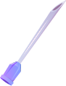

Requirements and Analysis
1
2
Activity diagram
Use case diagram
3
Flowchart diagram
4
EER diagram

Slide 9
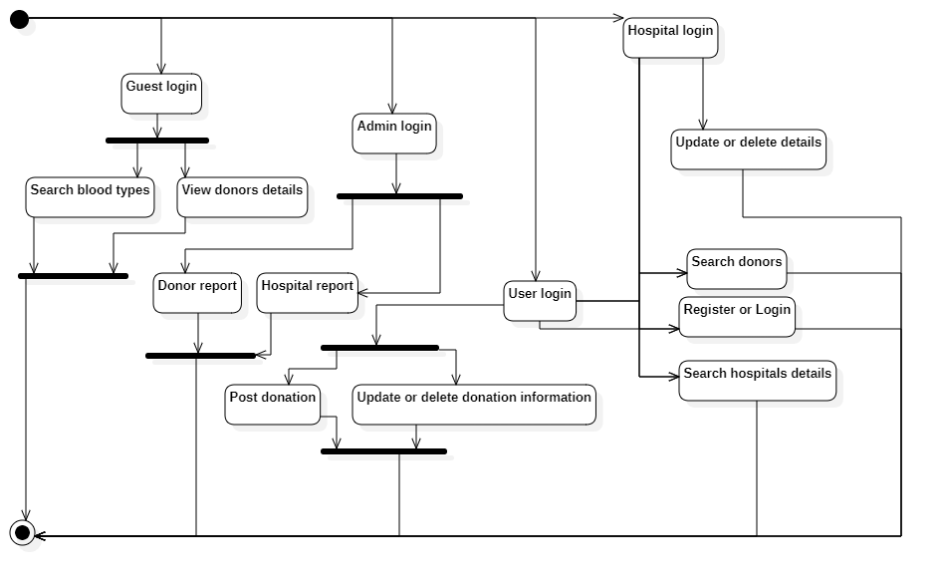
Activity diagram

Slide 10
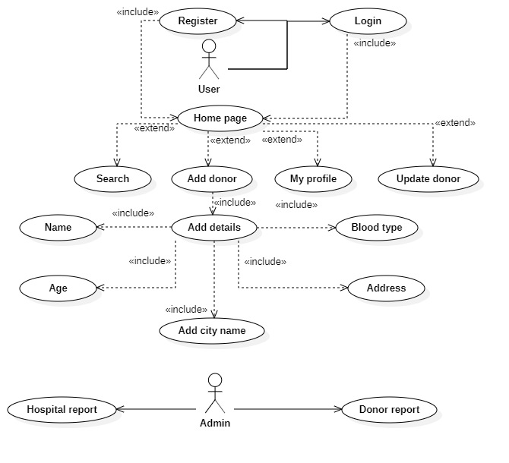
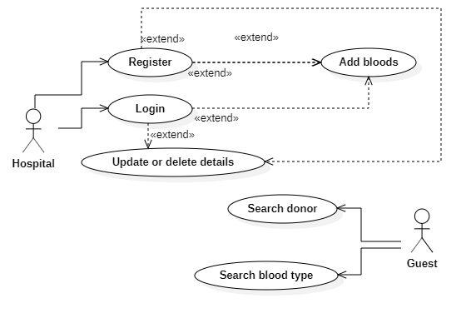
Use case diagram
User & Admin
Hospital & Guest

Slide 11
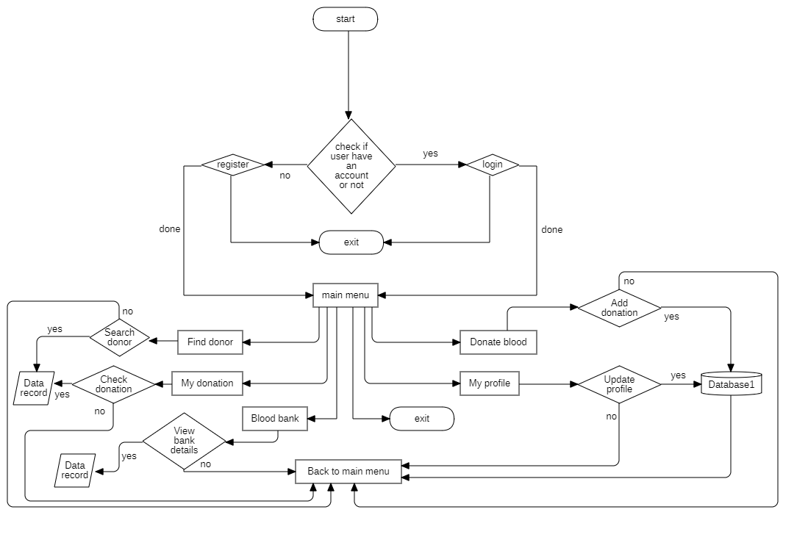
Flowchart diagram

Slide 12
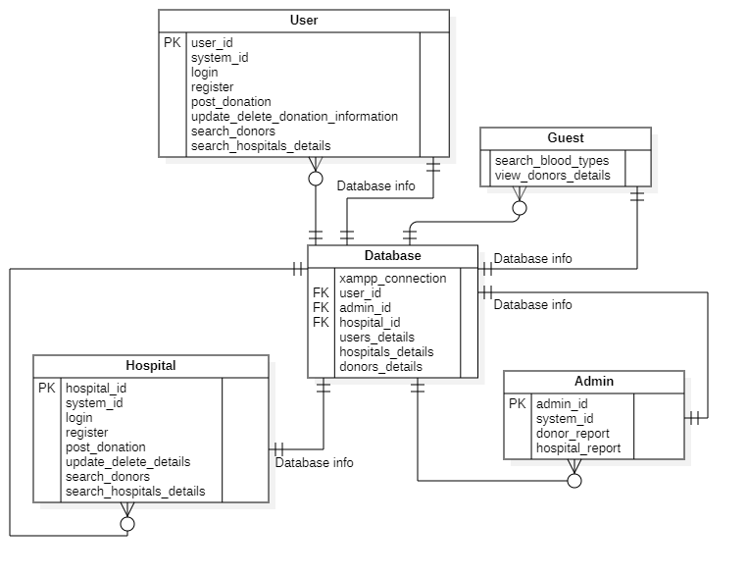
EER diagram

Slide 13
Project plan
There are many technologies are used in term of this project such as:
25%
HTML & CSS
45%
Javascript & Angular & XML
15%
PHP
Android Studio & VS Code

Slide 14
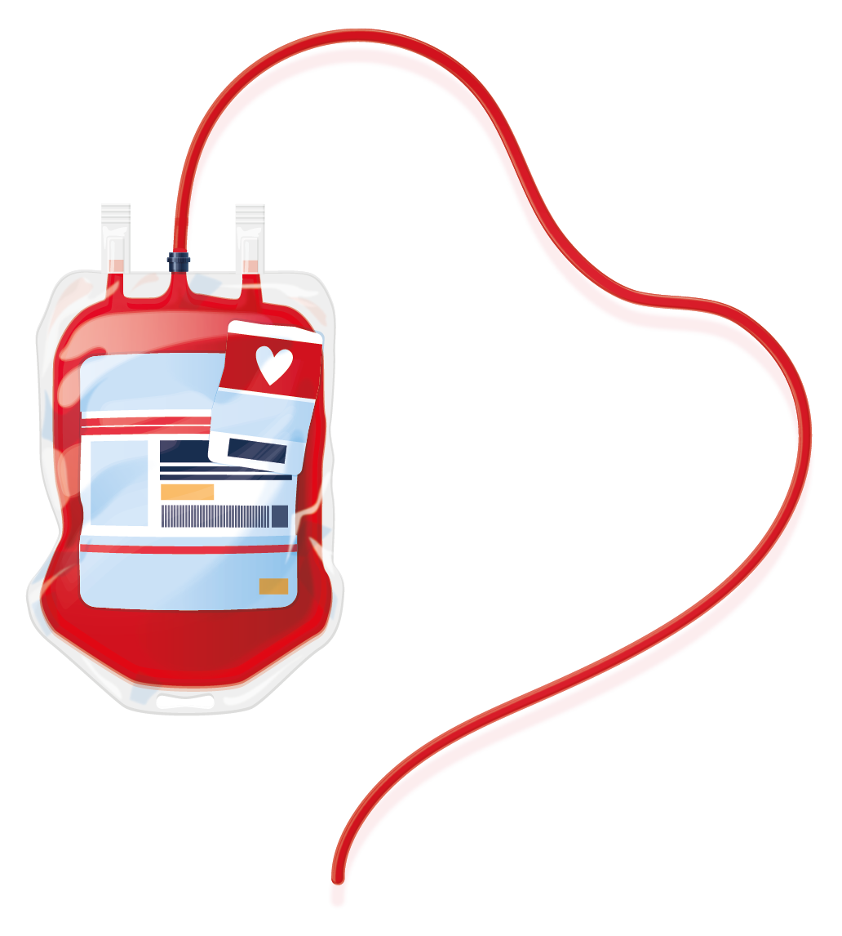
Methodology: Waterfall
Requirements
Analysis
Design
Implementation
Testing
Deployment
Maintenance

Slide 15
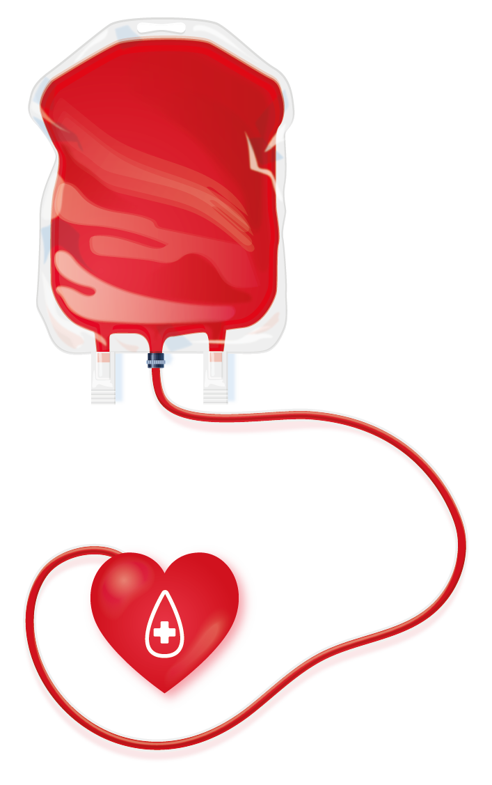
Objectives
Get more people to donate blood regularly.
Make it easier to collect blood efficiently.
Keep track of how much blood we have and use it wisely.
Work together with other organizations to improve how we do things.

Slide 16
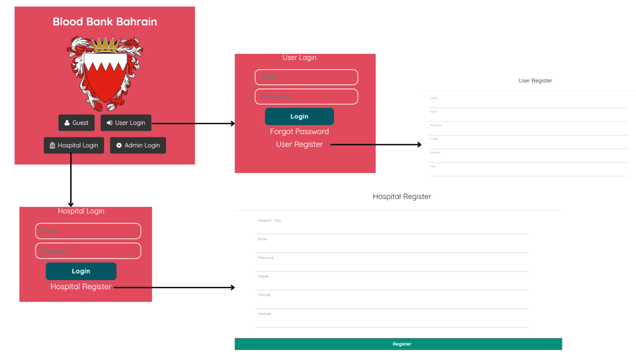
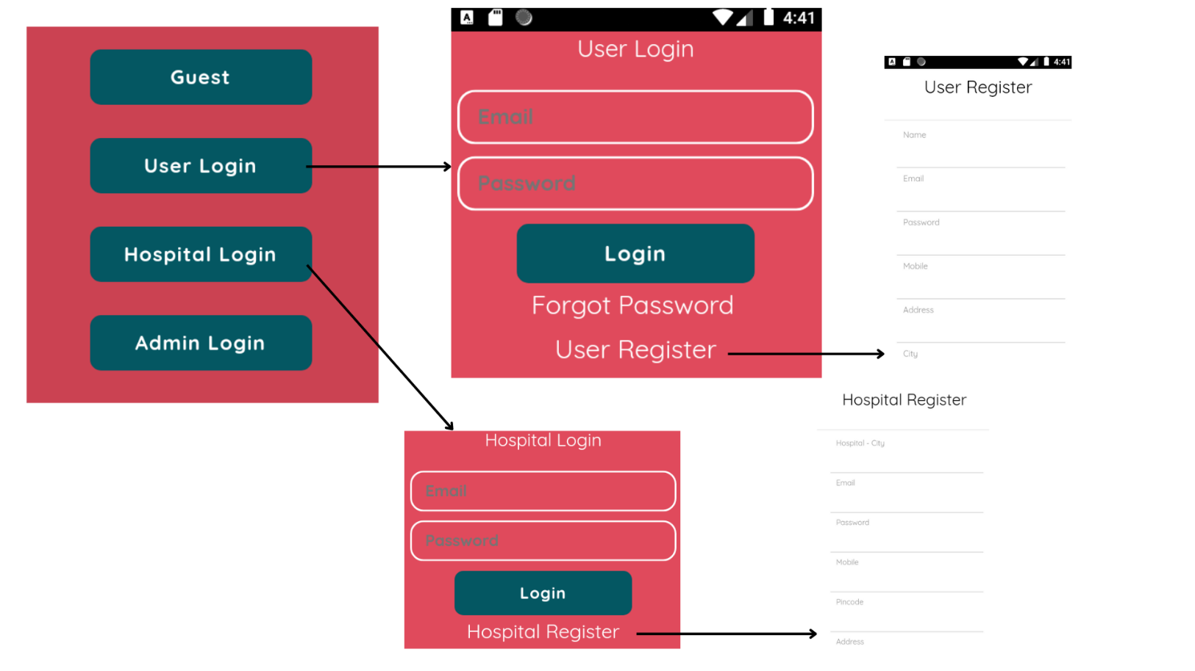
Blood Bank Bahrain (BBB) interface
Website
Application

Slide 17
Literature Review
Properties | Ministry of Health | Bahrain Red Crescent Society | Bahrain Open Data Portal | My application
Requires Registration | ✗ | ✓ | ✗ | ✓
Category-Based Search | ✓ | ✗ | ✓ | ✓
Text-Based Search Bar | ✓ | ✗ | ✗ | ✓
Creating report | ✗ | ✗ | ✓ | ✓
Admin Access | ✓ | ✓ | ✓ | ✓

Slide 18
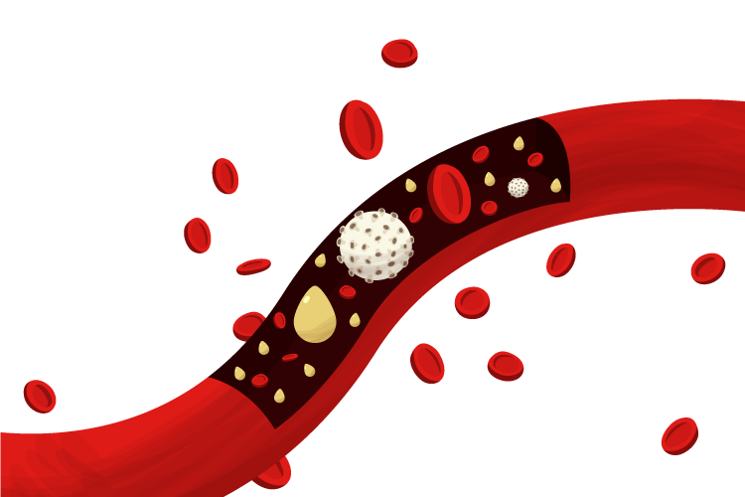
References
Blood Donation - Ministry of Health. (2024, 4 4). Ministry of Health. Retrieved from Blood Donation:
https://www.moh.gov.bh/healthinstitution/blooddonation?lang=en
Bahrain Red Crescent Society. (2024, 4 4). Retrieved from Bahrain Red Crescent Society:
https://www.rcsbahrain.org/en/donate/
Bahrain Open Data Portal. (2024, 4 4). Retrieved from Bahrain Open Data Portal:
https://www.data.gov.bh/pages/homepage/

Slide 19
Thank you for listening
Questions?

